Slide 1
LED Diver (Buck Converter)
- Controlled by Texas Instruments LM3409HV Buck Controller
- Steps down Application board 12V power to 6V, 0.5A max
- Output current adjustable via PWM to allow for LED dimming
- Drives two high power white LEDs

Slide 2
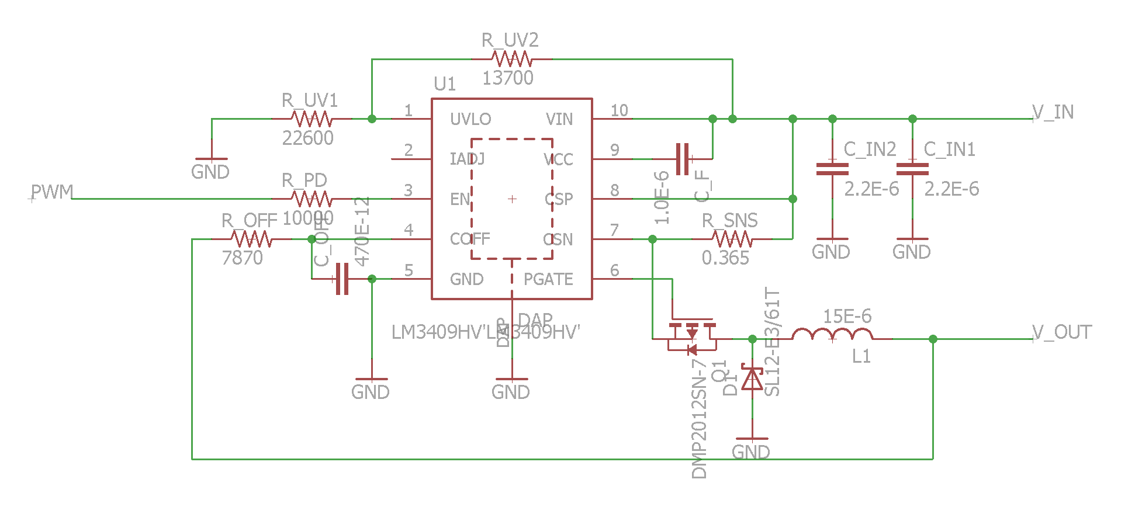
Schematic

Slide 3
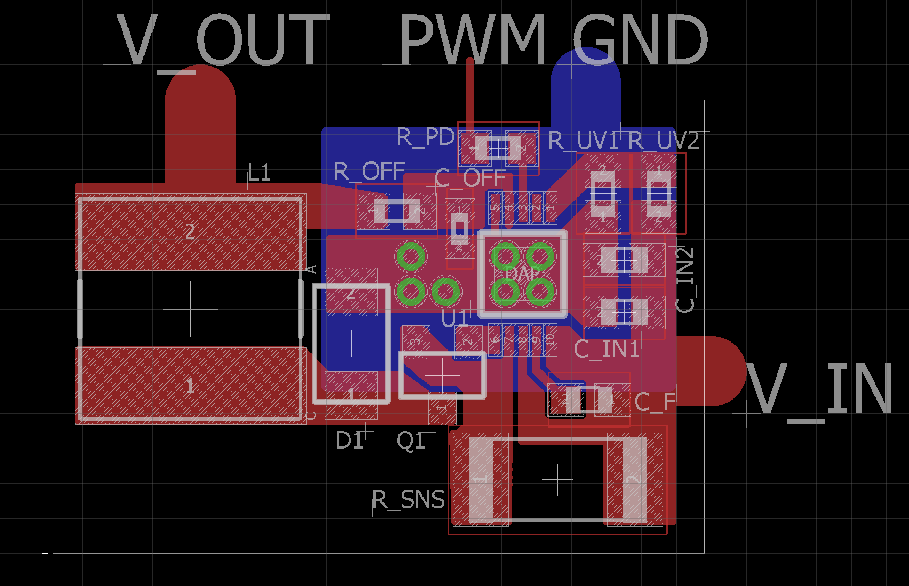
Board

Slide 4
Board (cont.)
Main considerations taken in design of the board:
No ground plane or traces opposite the inductor avoid effects of eddy currents
Input capacitors located as close to the chip power pins on the same layer
Drain of PFET connected as close as possible to power inductor, with minimal trace area
Place output capacitor close to the inductor
At least 4 thermal vias located under the buck controller thermal pad for heat dissipation
Isolate small signal ground (IC ground) from the power ground

Slide 5
Board (cont.)
Minimise the use of vias for the power ground
Isolate noise-causing components (diode, inductor, PWM signal) away from other components
In particular, there recommendations for designing the feedback route. However the design of our particular driver makes them somewhat irrelevant.
Proper land pattern of power components to minimize impedance: (Application Notes 136, Page 7)
http://cds.linear.com/docs/en/application-note/an136f.pdf

